Slide 1


micro:bit module video tutorial
micro:bit
preparation before class
YahBoom micro:bit video tutorial

Slide 2
micro:bit module video tutorial
Content
Part 1
Part 2
Part 3
Part 4
micro:bit introduce
Open programming web
Add YahBoom extension
Downtown
YahBoom Micro:bit video tutorial

Slide 3

micro:bit module video tutorial
Part 1
What's micro:bit?
Micro:Bit is a microcomputer designed by the BBC for adolescent programming education, which is developed by Microsoft, Samsung, ARM, University of Lancaster, UK and so on.
YahBoom micro:bit video tutorial

Slide 4
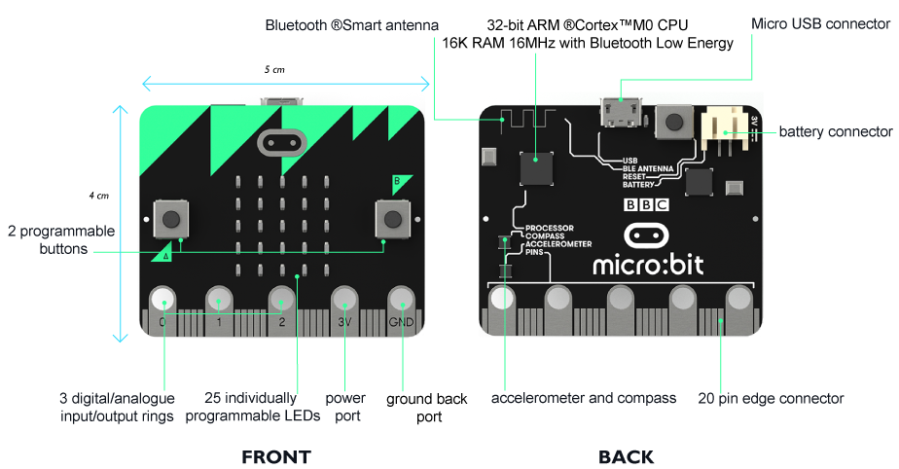
micro:bit module video tutorial
Part 1
micro:bit
features
YahBoom micro:bit video tutorial

Slide 5
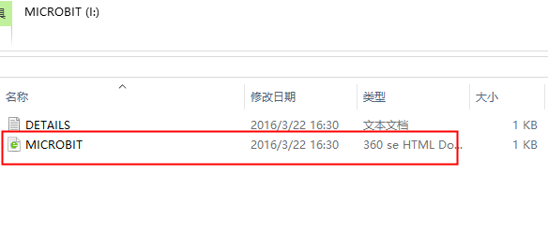
micro:bit module video tutorial
Part 2
1.First, you use the USB cable to connect the micro:bit to the computer, at this point, the computer will have a micro:bit U disk. Open it, click micro:bit website, then entered the micro:bit website
How to open a programming web page?
YahBoom micro:bit video tutorial

Slide 6

micro:bit module video tutorial
Part 2
2.After entering the micro:bit, click Let's Code
How to open a programming web page?
YahBoom micro:bit video tutorial

Slide 7
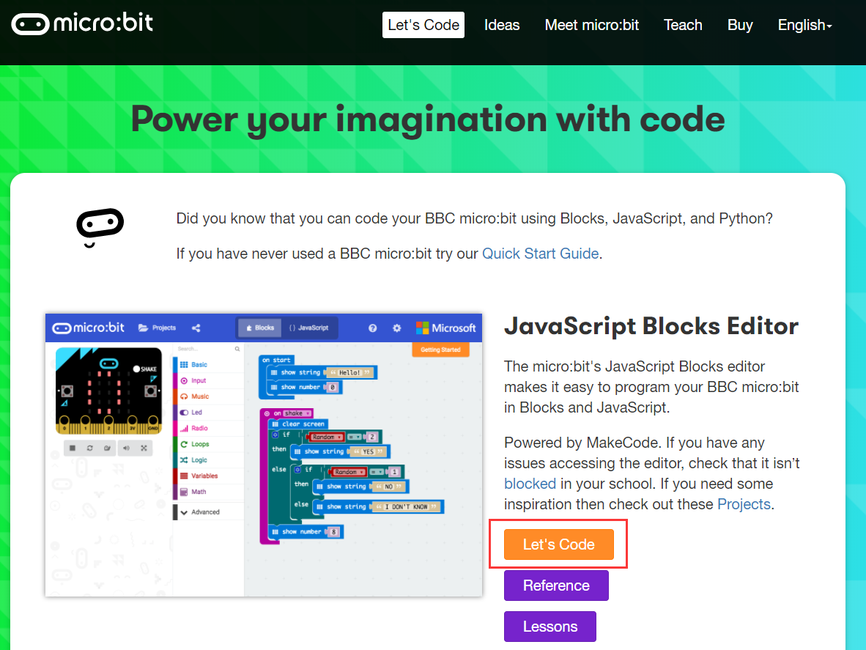
micro:bit module video tutorial
Part 2
When you get into a new page, click on the screen below [Let's Code],
You can get into the programming page.
How to open a programming web page?
YahBoom micro:bit video tutorial

Slide 8
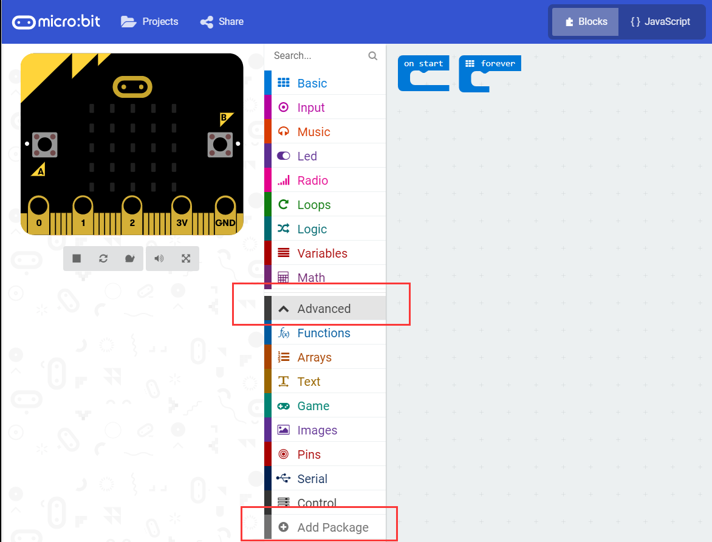
micro:bit module video tutorial
Part 3
Click Advanced, then Click Add Package
How to add YahBoom extension
YahBoom micro:bit video tutorial

Slide 9
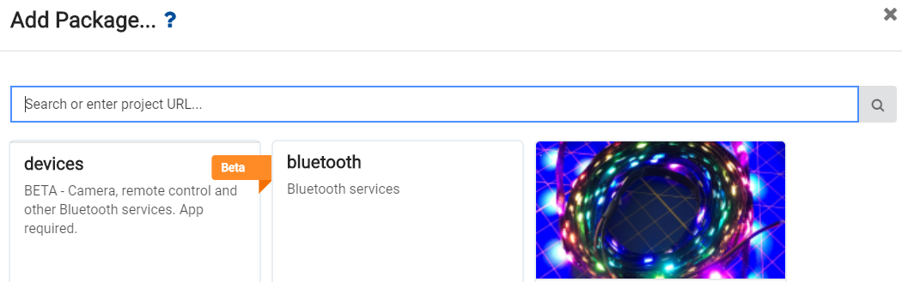
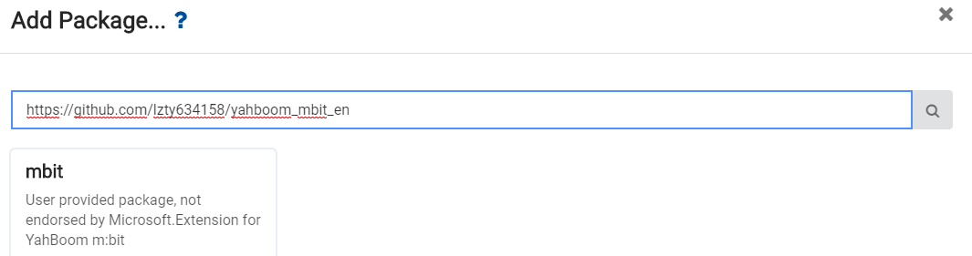
micro:bit module video tutorial
Part 3
Enter the URL in the input column:https://github.com/lzty634158/yahboom_mbit_en
Then click Mbit, and you can add the package successfully.
How to add YahBoom extension
YahBoom micro:bit video tutorial

Slide 10
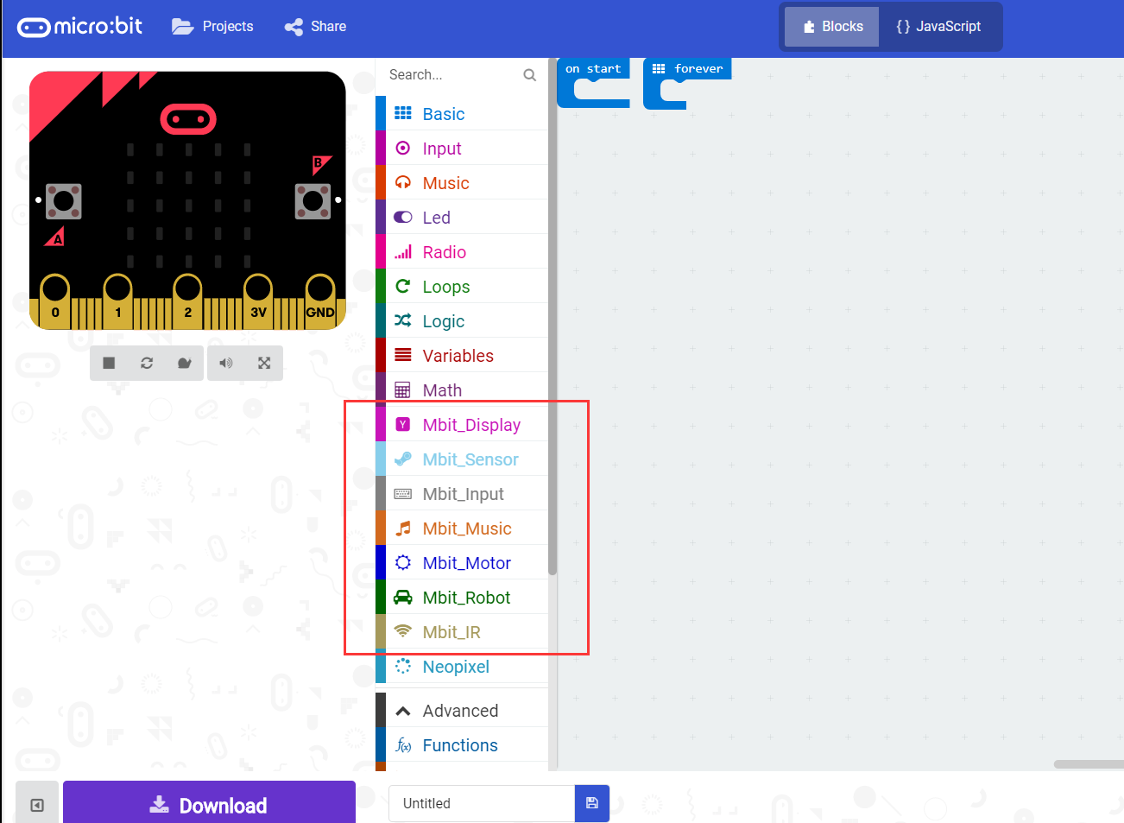
micro:bit module video tutorial
Part 3
After loading the package, we can see that the program bar has loaded the blocks made by YahBoom.
How to add YahBoom extension
YahBoom micro:bit video tutorial

Slide 11
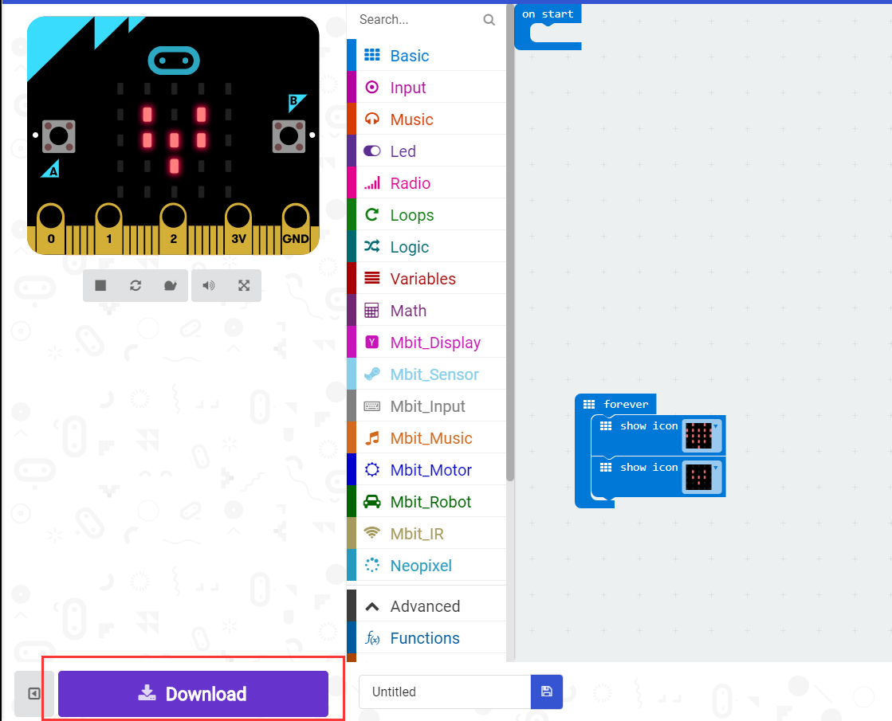
micro:bit module video tutorial
Part 4
After the building blocks, click Download. You can set the download path in the U disk of micro:bit, download it to the computer, and then copy it to the U disk in micro:bit.
How to download
micro:bit code?
YahBoom micro:bit video tutorial

Slide 12
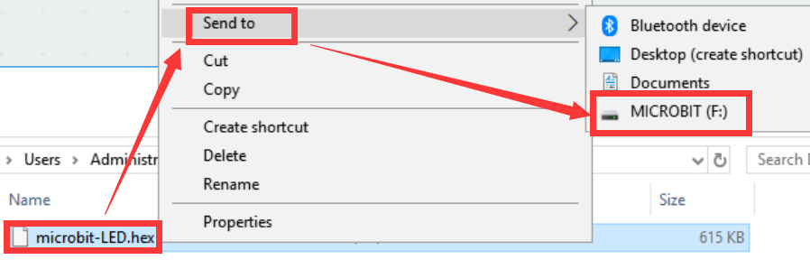
micro:bit module video tutorial
Part 4
How to download
micro:bit code?
YahBoom micro:bit video tutorial

Slide 13
micro:bit module video tutorial
micro:bit
project
Thanks for watching！
Powered by YahBoom
YahBoom Micro:bit video tutorial

